Slide 1
Análisis descriptivo
Aprendizaje Automático 1

Slide 2
Librerías:
import pandas as pd
import numpy as np
from scipy.stats import zscore
import matplotlib as plt
import seaborn as sns
Dataset:

Slide 3
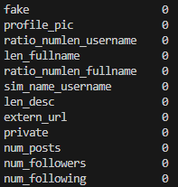
Valores nulos:
nan_count = df.isna().sum()

Slide 4
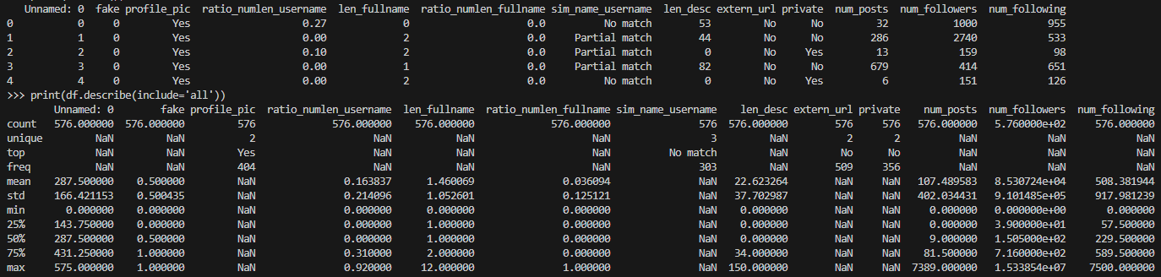
#Se puede acceder por partes:
print(df['num_followers'].count())
print(df['num_followers'].mean())
print(df['num_followers'].std())
print(df['num_followers'].min())
print(df['num_followers'].quantile(q=0.25))
Estadísticas descriptivas:
print(df.describe(include='all'))

Slide 5
Outliers:
q_low = df["num_followers"].quantile(0.01)
q_hi = df["num_followers"].quantile(0.99)
df_filtered = df[(df["num_followers"] < q_hi) & (df["num_followers"] > q_low)]
print(len(df. index))-> 576
print(len(df_filtered. index)) -> 552

Slide 6
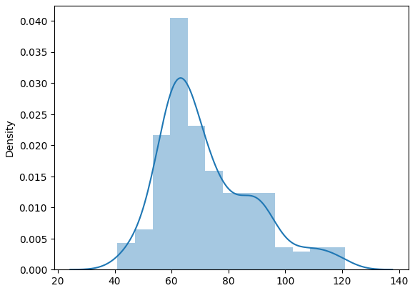
Gráficos:
sns.distplot(df["ratio_numlen_username"], kde=True, rug=False)

Slide 7
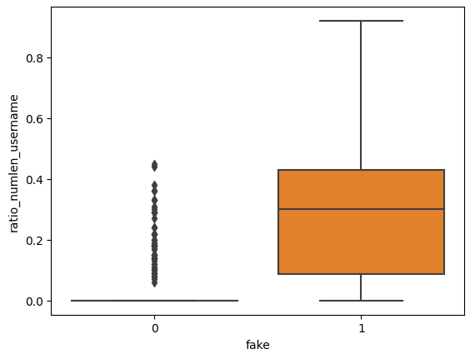
sns.boxplot(x='fake', y='ratio_numlen_username', data=df)
A

Slide 8
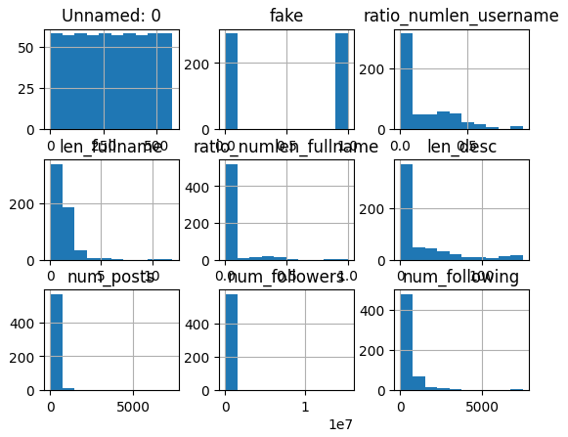
df.hist()

Slide 9
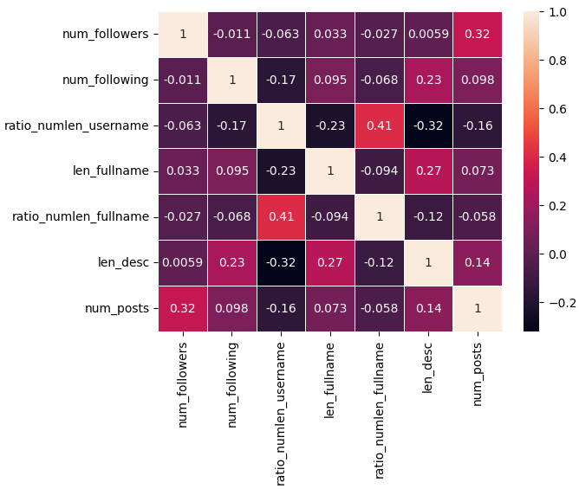
df_numeric = df[['num_followers', 'num_following', "ratio_numlen_username","len_fullname", "ratio_numlen_fullname", "len_desc", "num_posts"]]
corrmat = df_numeric.corr()
print(corrmat)
sns.heatmap(corrmat, vmax=1, annot=True, linewidths=.5)

